Slide 1



Cross-Reference Stitching Quality Assessment for 360◦ Omnidirectional Images
P5B-02
ACMMULTIMEDIA 2019
Jia Li^{1,2,3}, Kaiwen Yu¹, Yifan Zhao¹, Yu Zhang¹, Long Xu²
¹State Key Laboratory of Virtual Reality, Beihang University
²National Astronomical Observatories, Chinese Academy of Sciences
³Beijing Advanced Innovation Center for Big Data and Brain Computing, Beihang Univ.

Slide 2
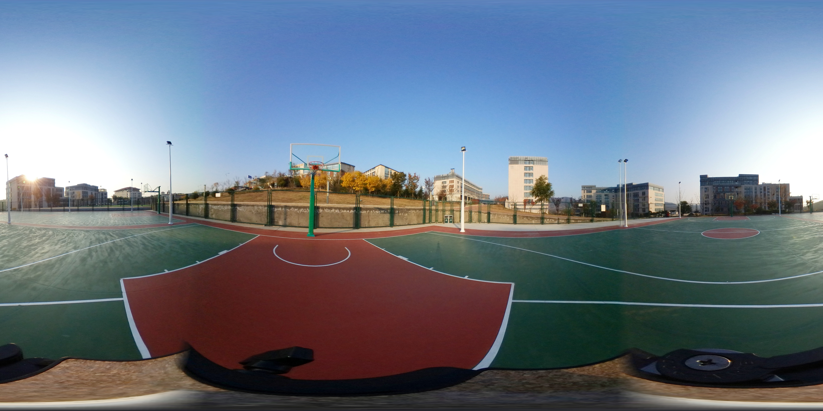
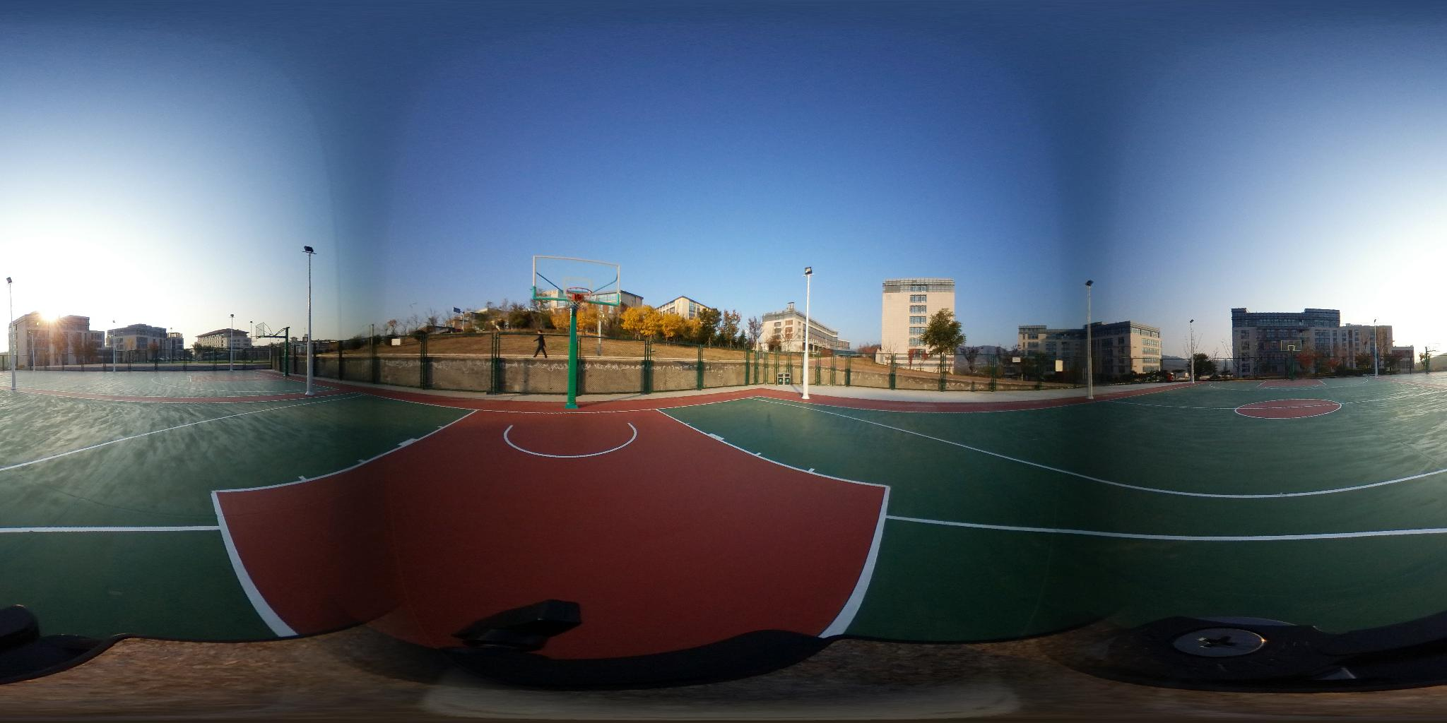
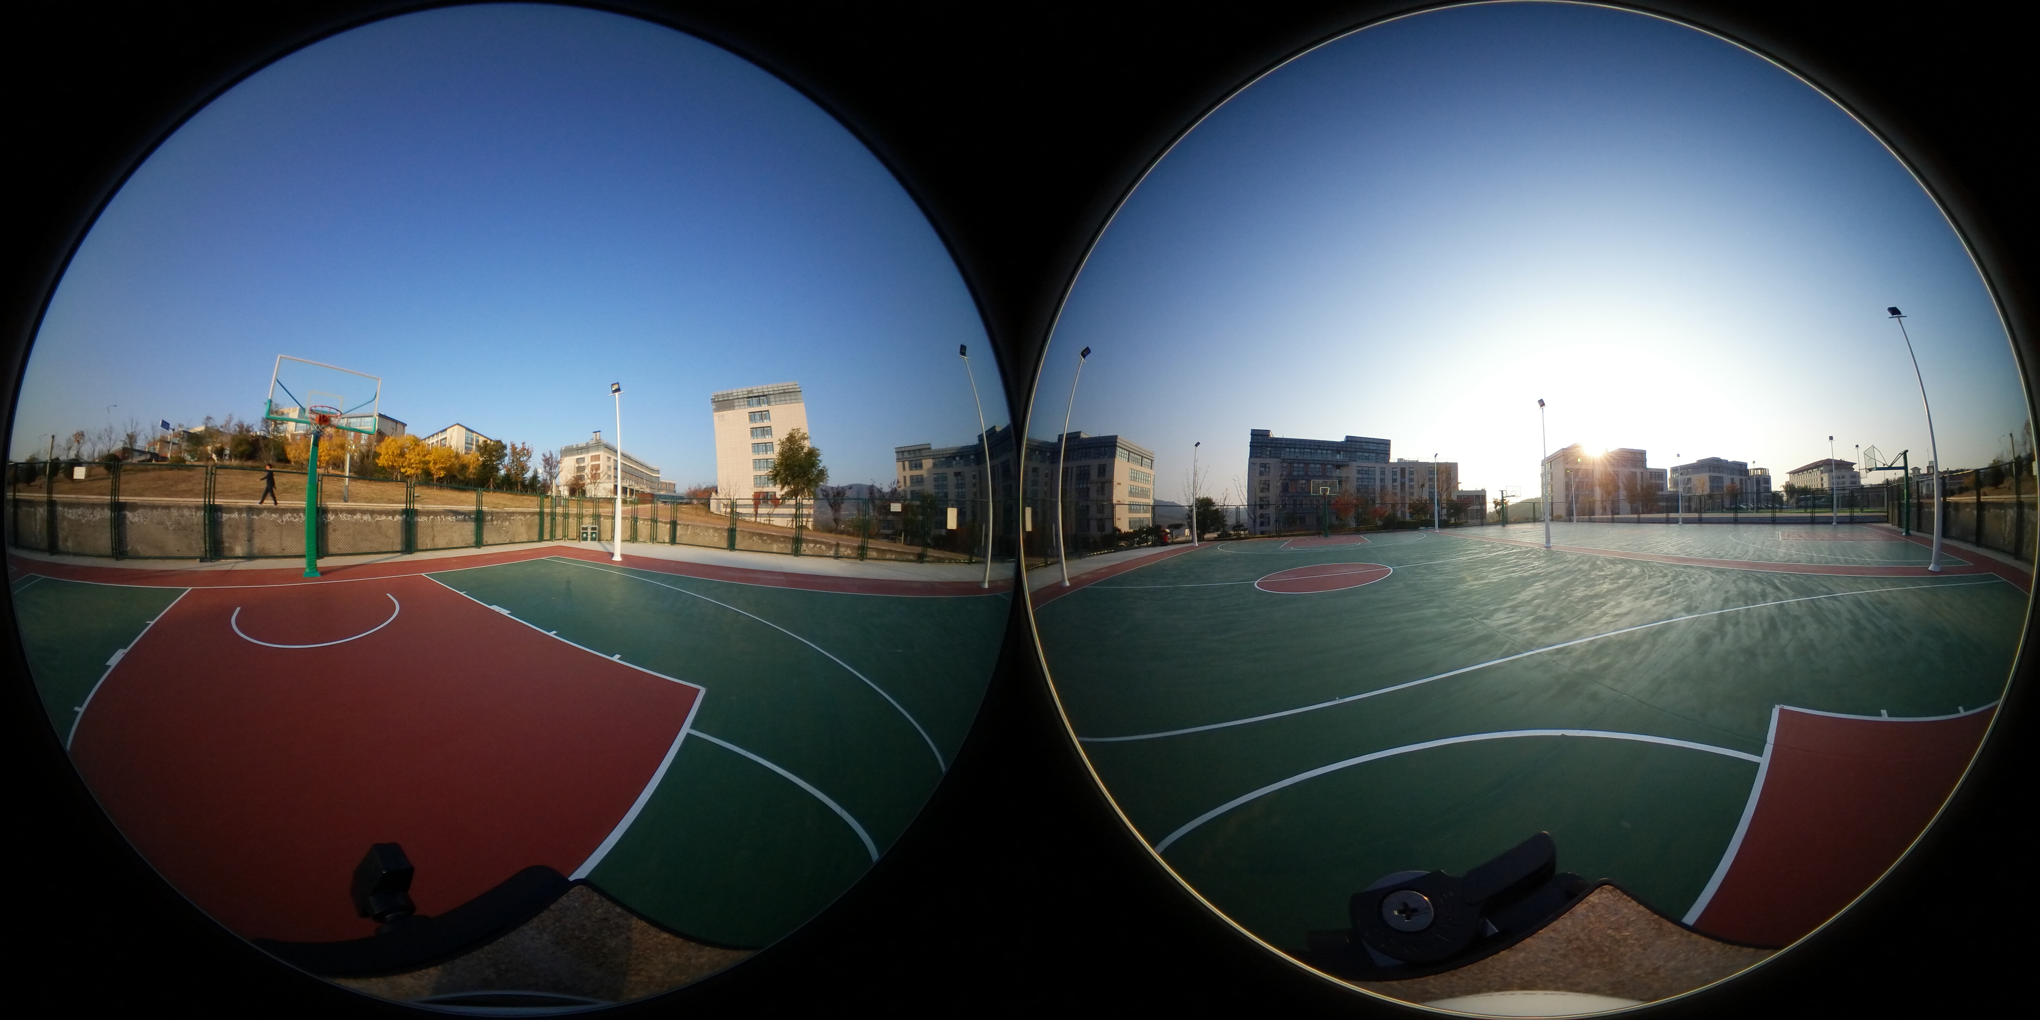
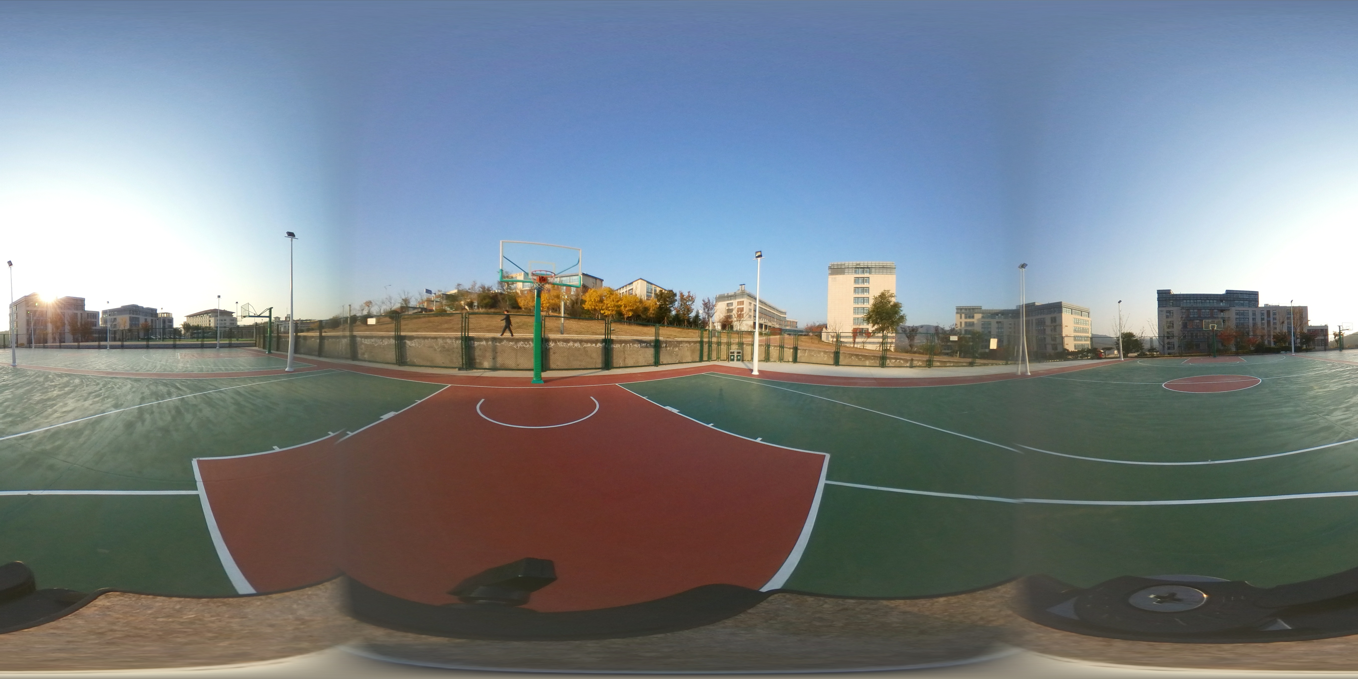
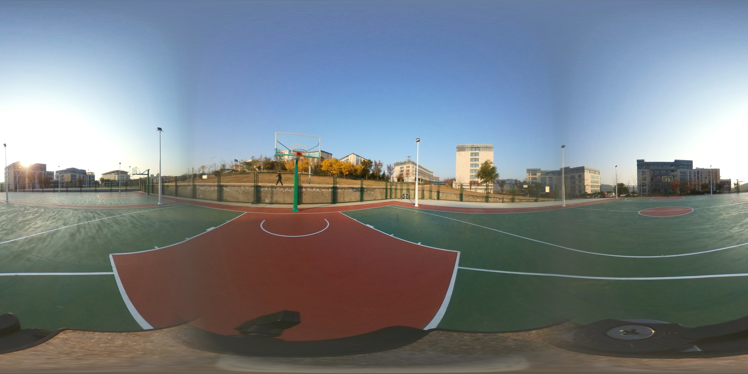
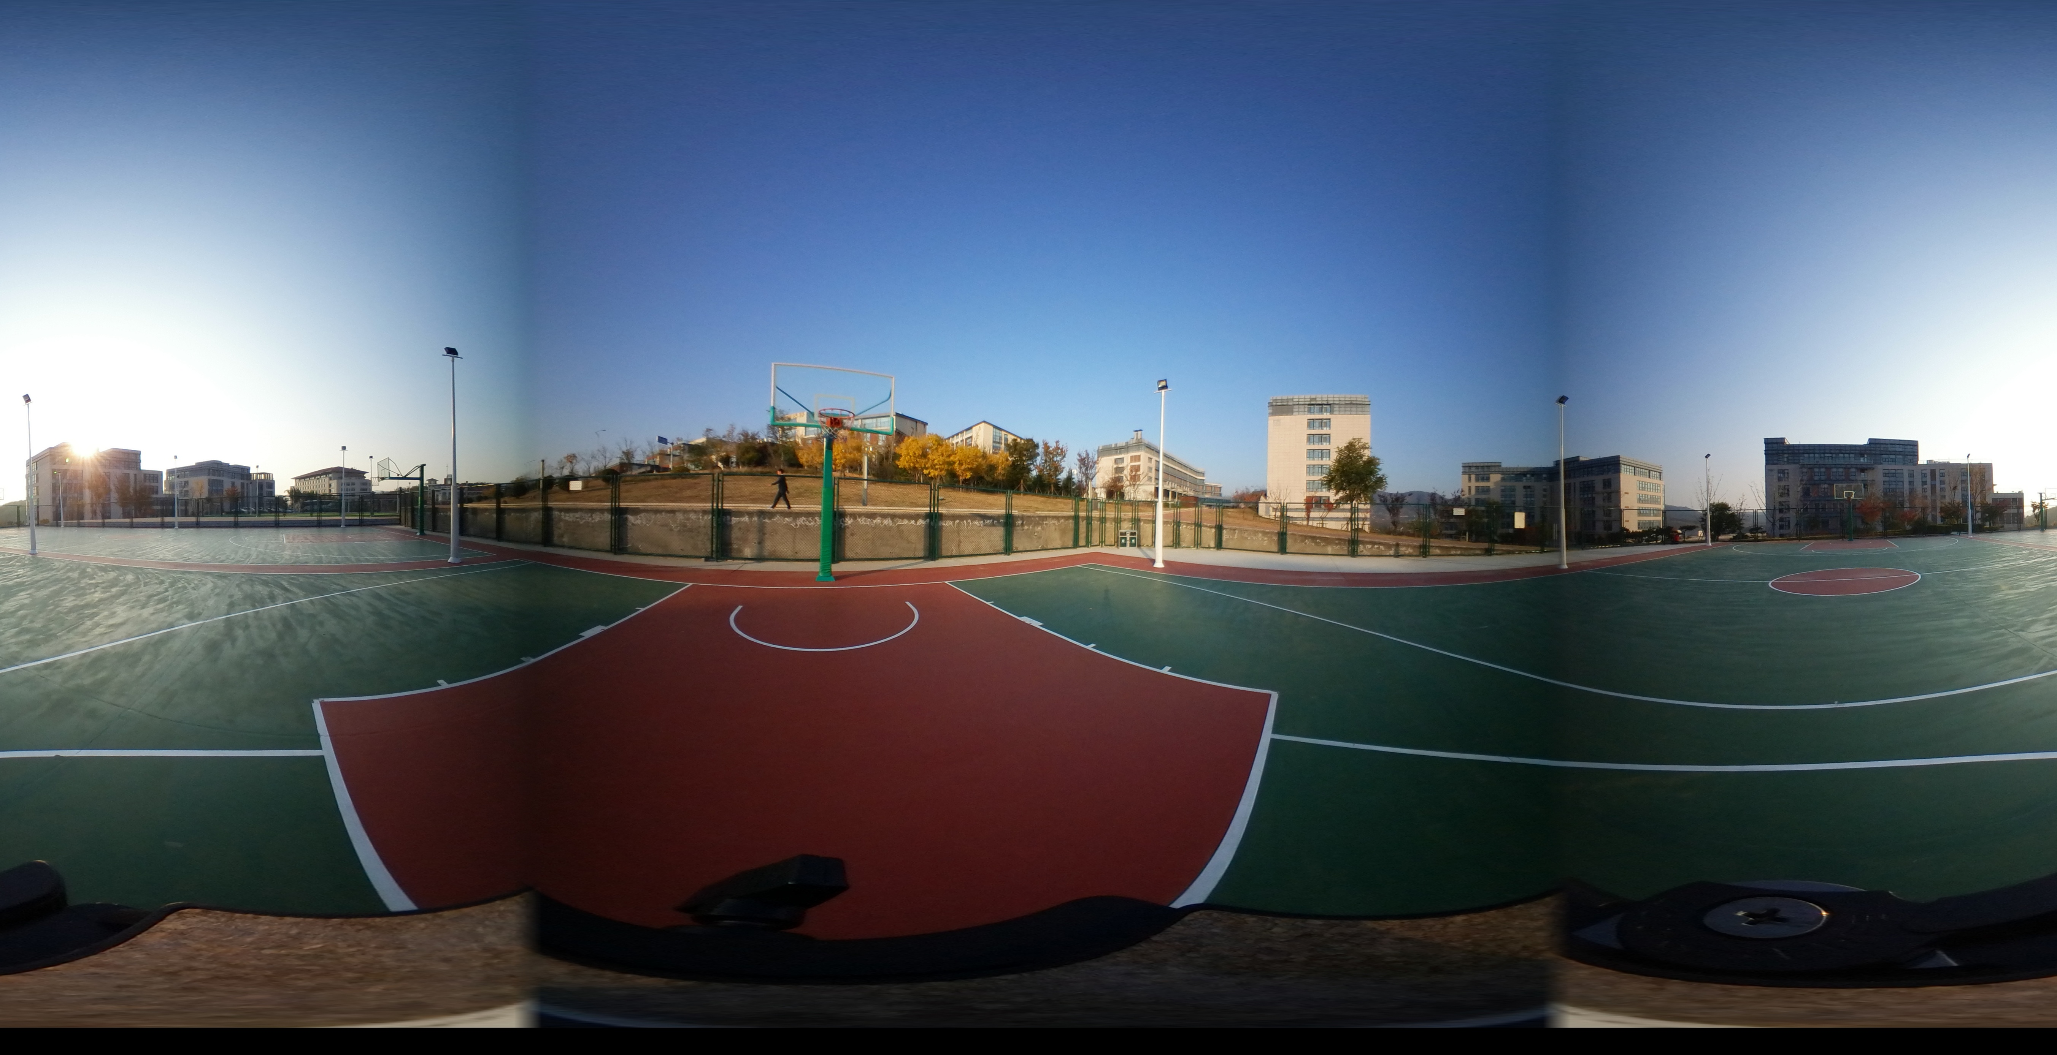
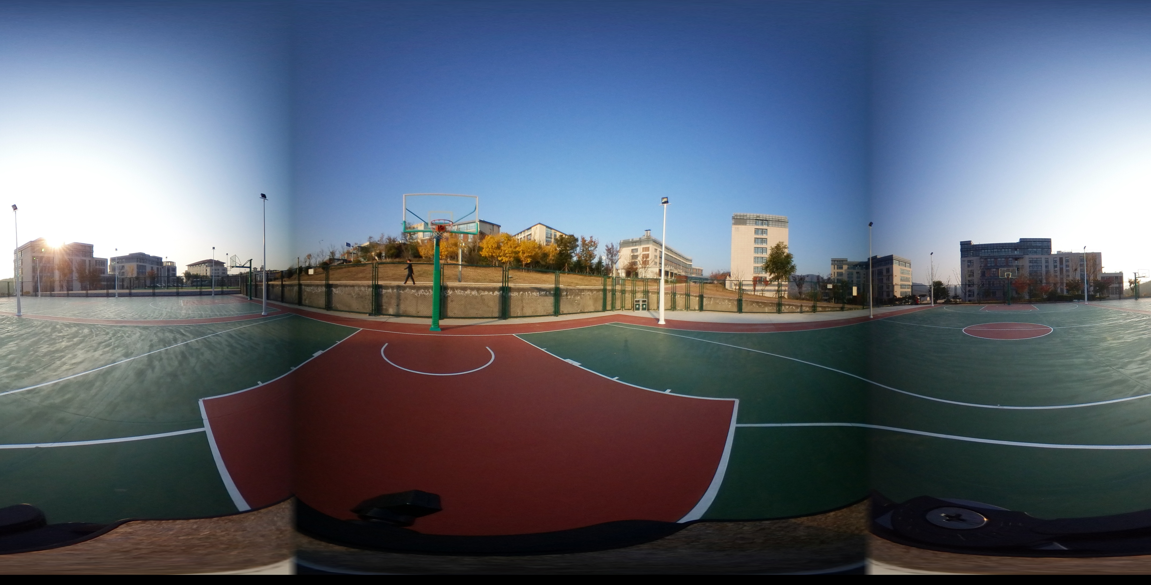
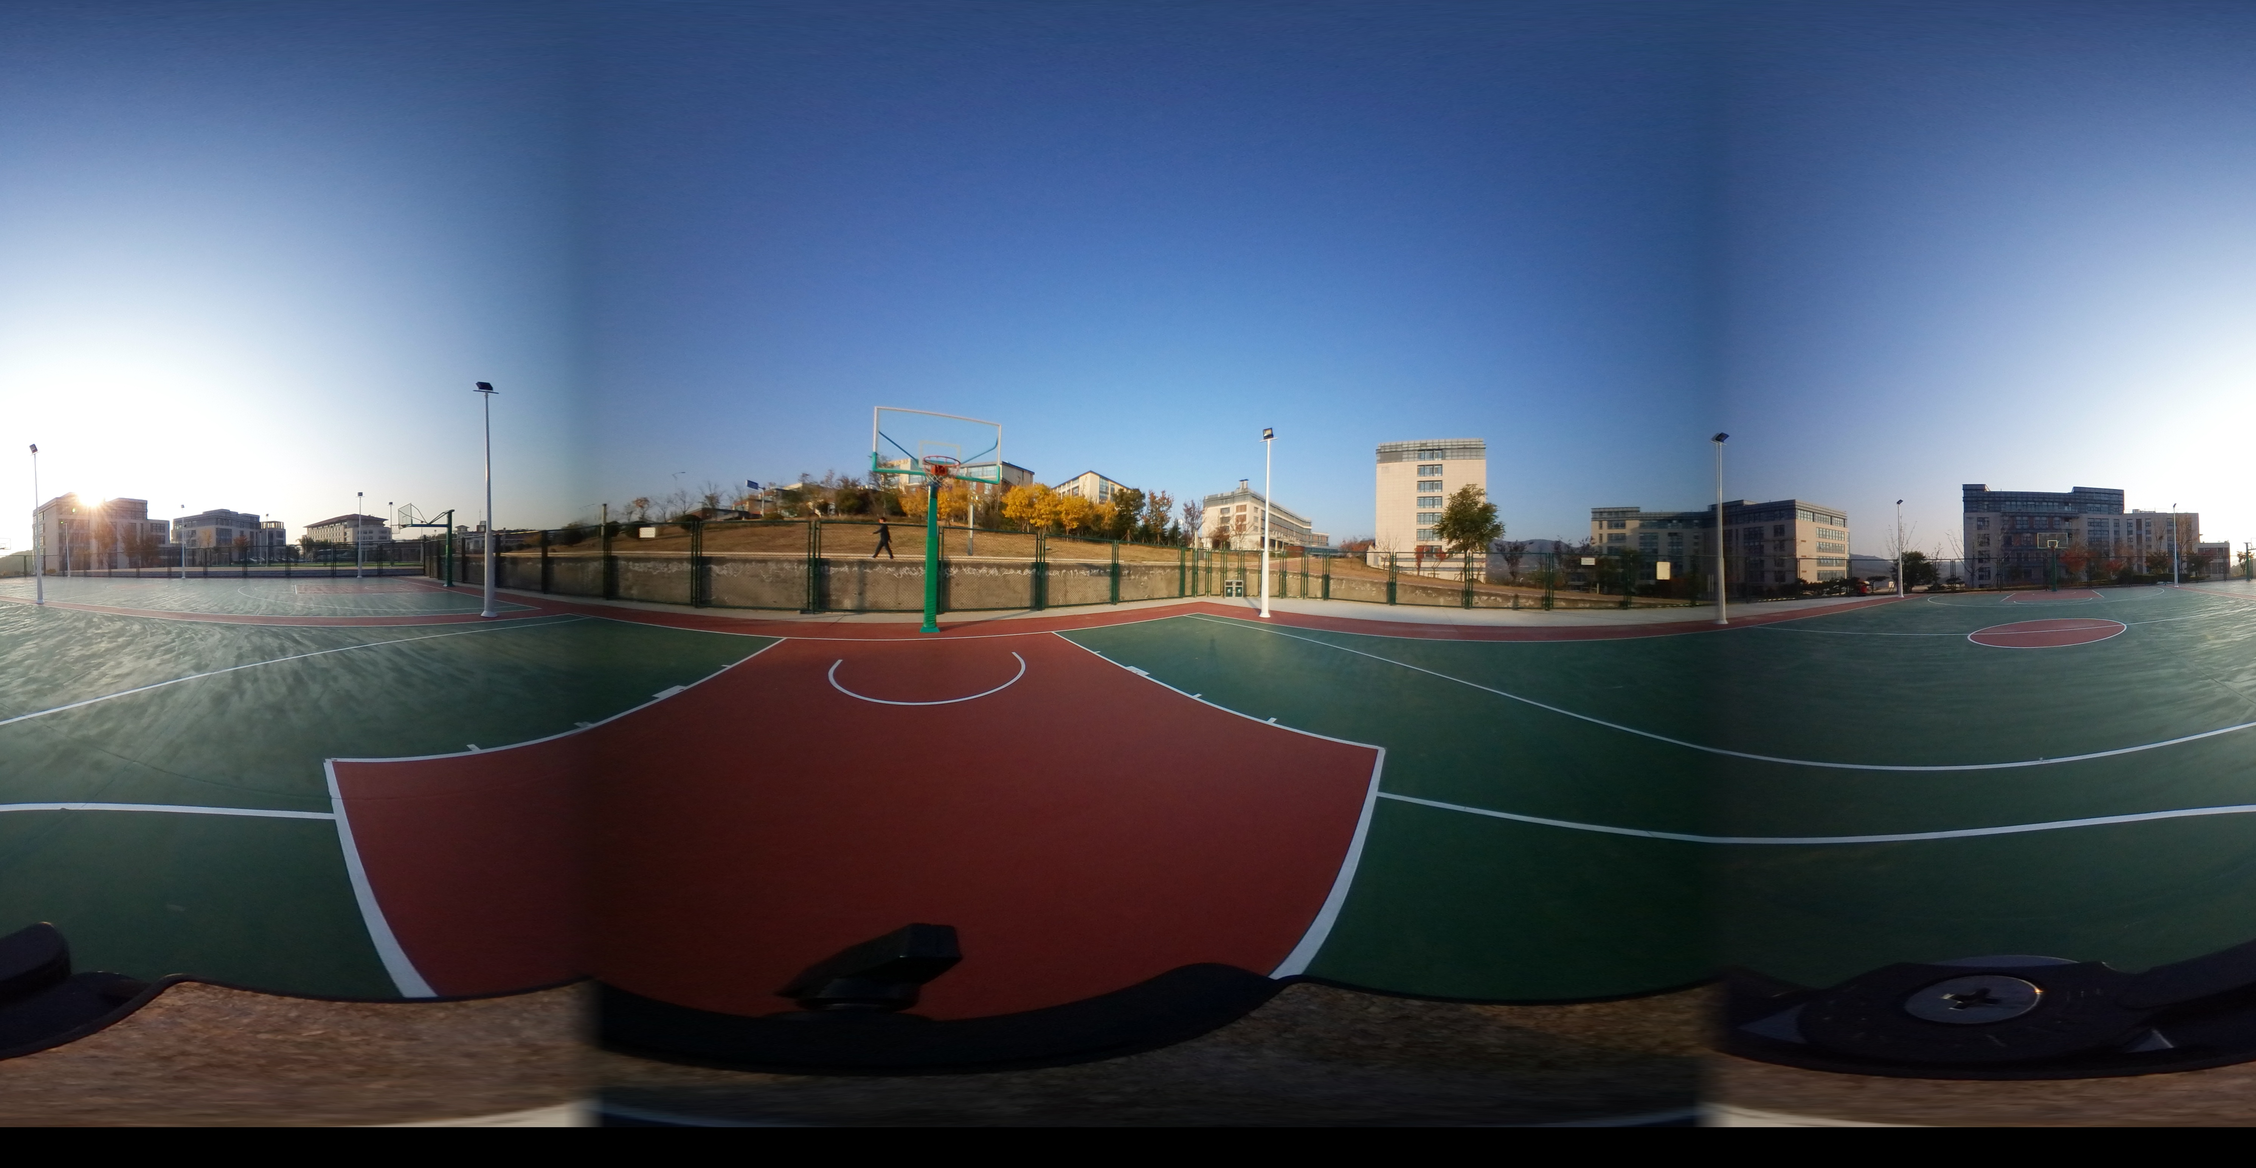
Background
Omnidirectional Image Quality Assessment
0°
180°
Model 1, Param x
A
B
Model 2, Param y
E
F
…
D
C
G
Model n
Param z
Dual Fisheye Image
Stitching Algorithms
Stitched Images
Which is the best stitching method and image?

Slide 3
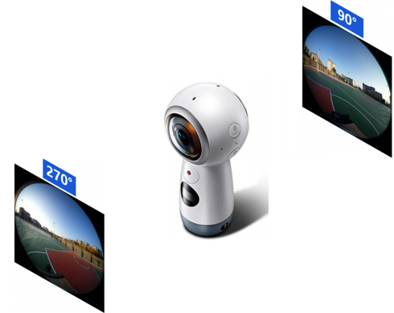
Motivation
Conventional Setting of Omnidirectional Image Quality Assessment:
A stitched image and its corresponding ground truth
Image Quality Assessment Metrics
Stitched Image
Hard to get?
Accumulated error?
Dual Fisheye Camera
Manual Calibrated GT

Slide 4
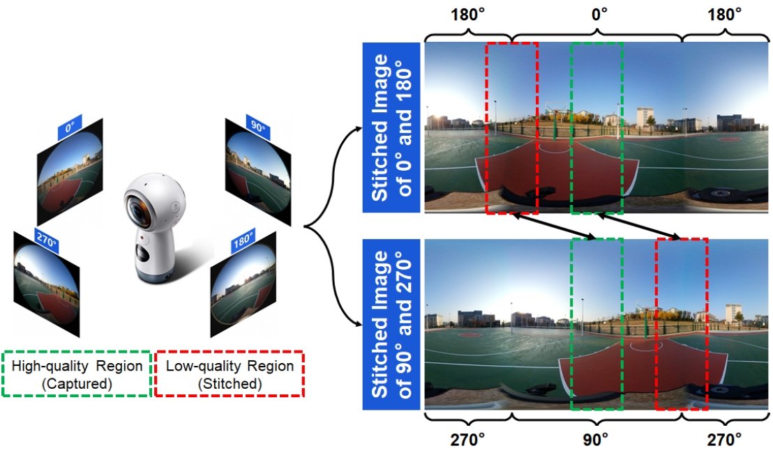
Motivation
Cross-reference: Omnidirectional capturing with quadruple fisheye images captured at 0, 90, 180, 270 degrees.
Cross-Reference

Slide 5
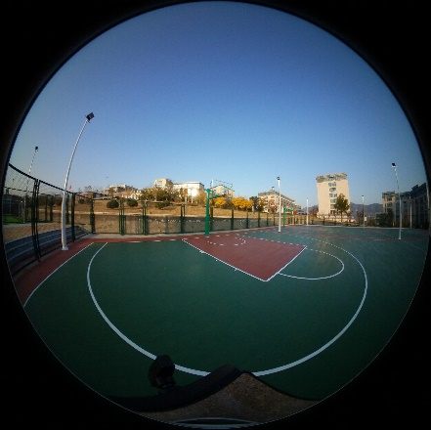
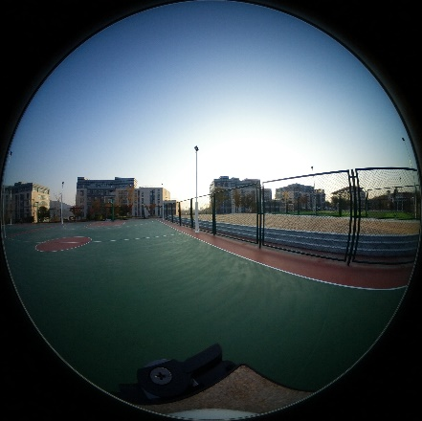
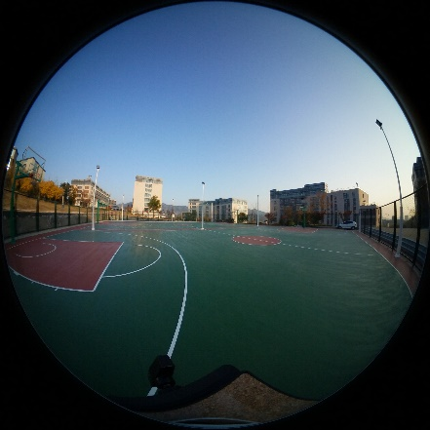
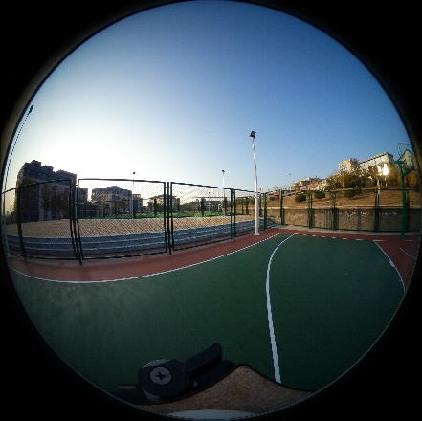
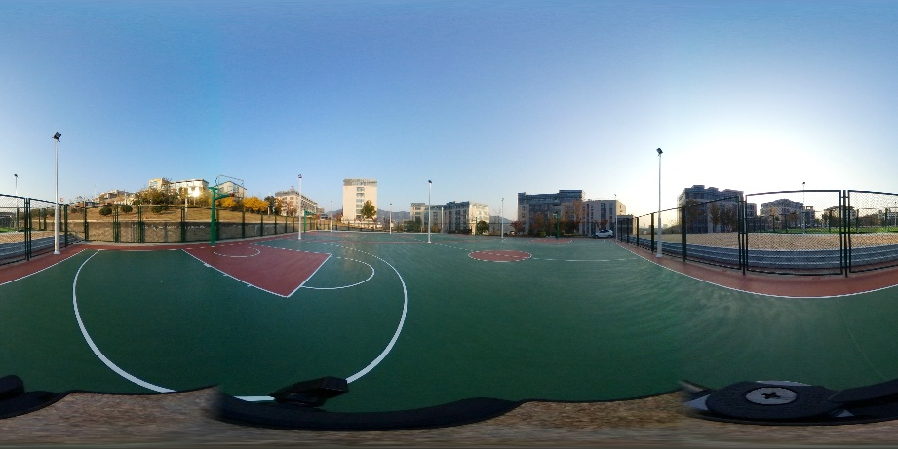
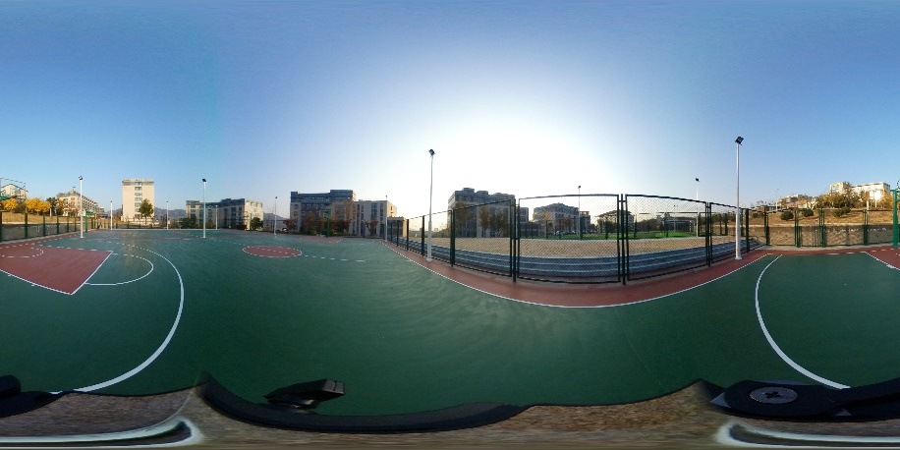
Dataset
CROSS: Cross-Reference Omnidirectional Stitching data Set
Dual Fisheye
Quaternions
180°
0°
270°
90°
360°Reference
Reference GT
Reference GT

Slide 6
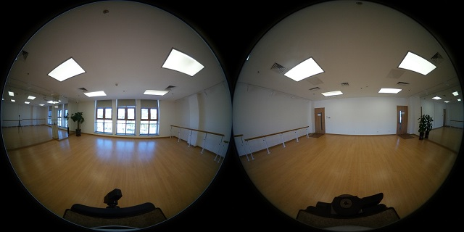
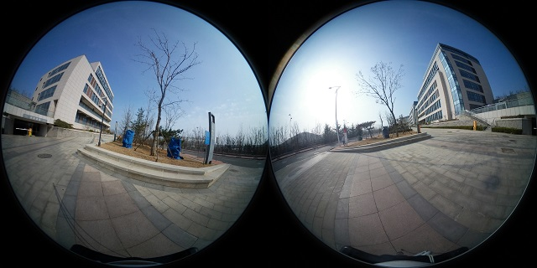
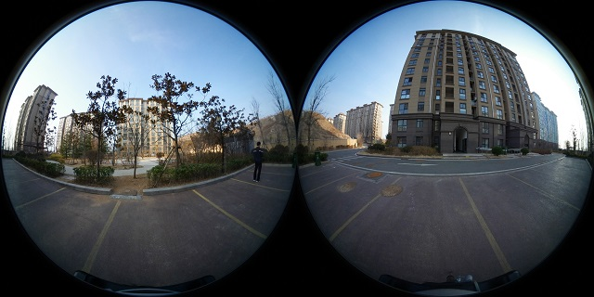
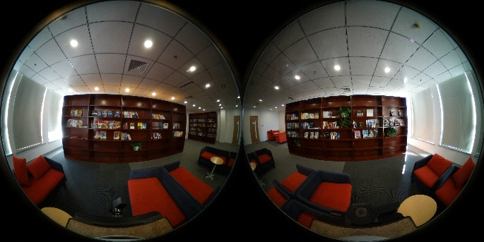
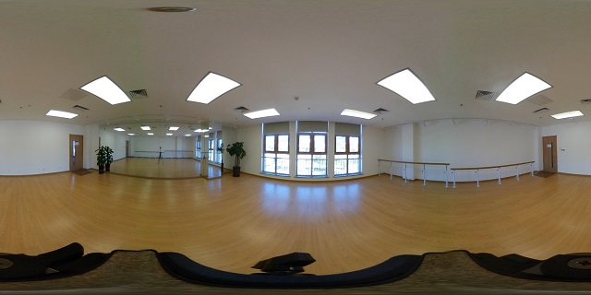
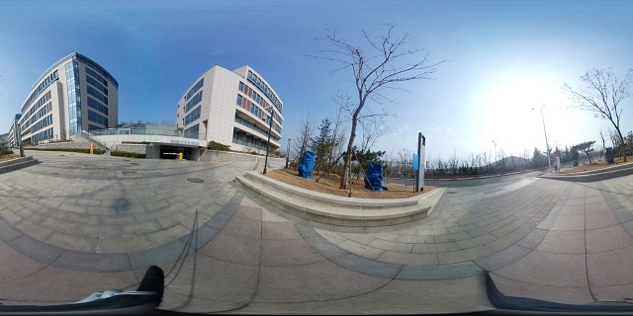
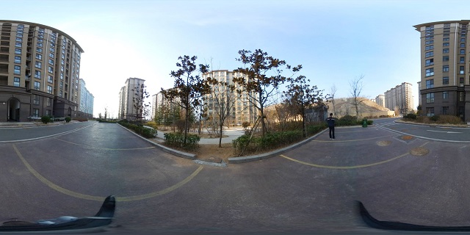
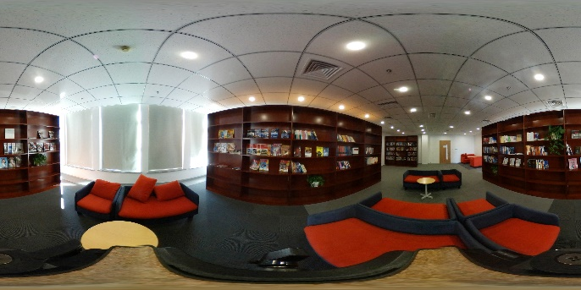
Dataset
CROSS: Cross-Reference Omnidirectional Stitching data Set
Dual Fisheye Images
Reference GT
Statistics:
Group: 292 quaternions of fisheye images and the stitching results of 7 methods.
Resolution: 5792 × 2896

Slide 7
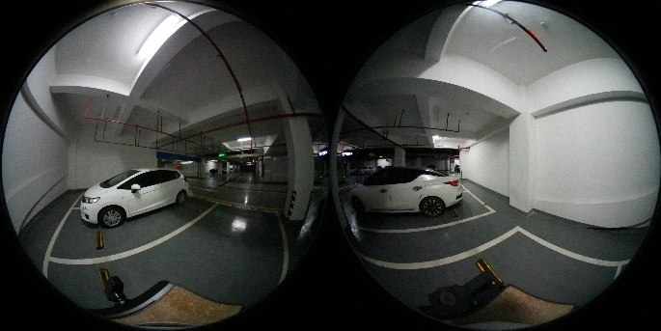
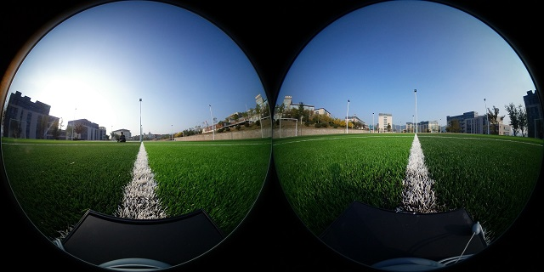
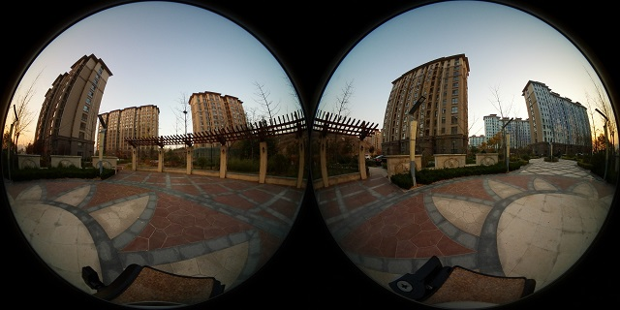
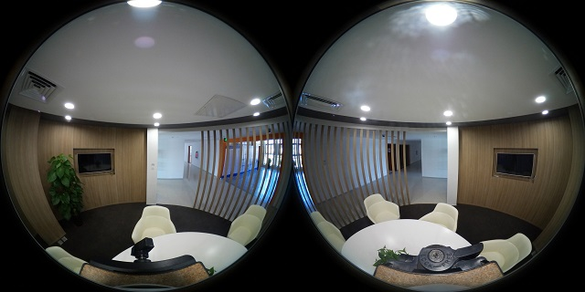
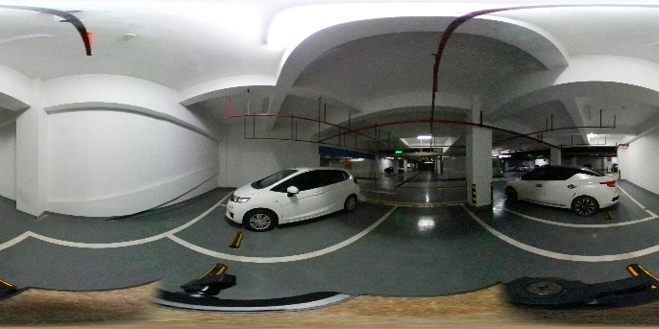
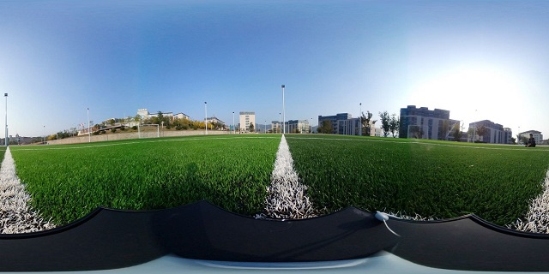
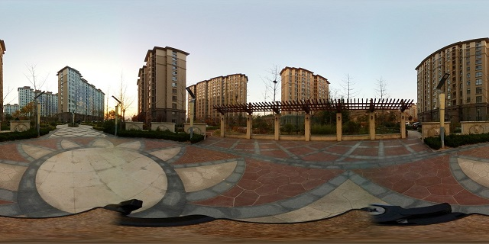
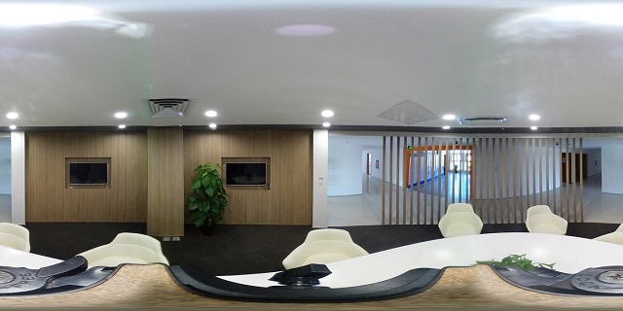
Dataset
CROSS: Cross-Reference Omnidirectional Stitching data Set
Dual Fisheye Images
Reference GT
10 Representative Scenarios:
Indoor : meeting room, classroom, stairs, underground park, dance room, reading room
Outdoor : street, wild area, basketball court, and residential area.

Slide 8
Method
Cross-reference: when evaluating the image stitched from a pair of fisheye images (e.g., 0◦ and 180◦), the other pair of fisheye images (e.g., 90◦ and 270◦) can be used as the cross-reference to provide ground-truth observations of the stitching regions.
Same Region
Provide:
Less Distortion
Less Aberration

Slide 9
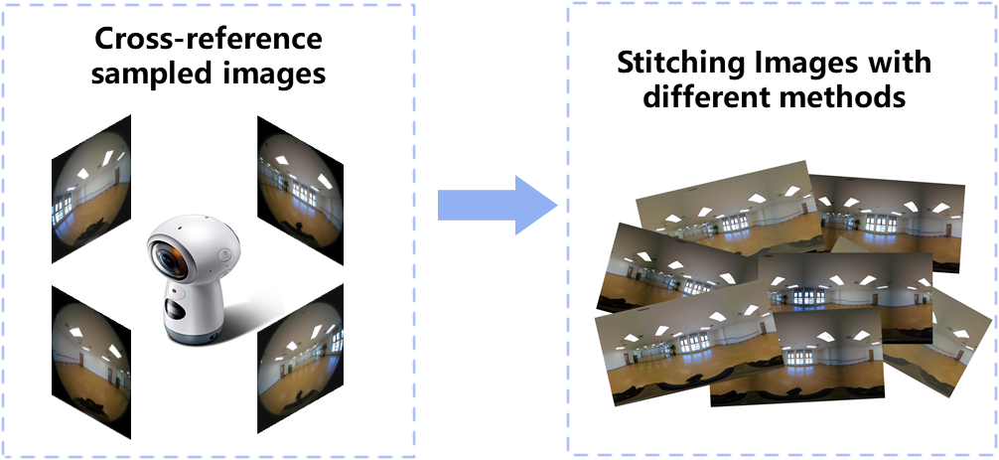
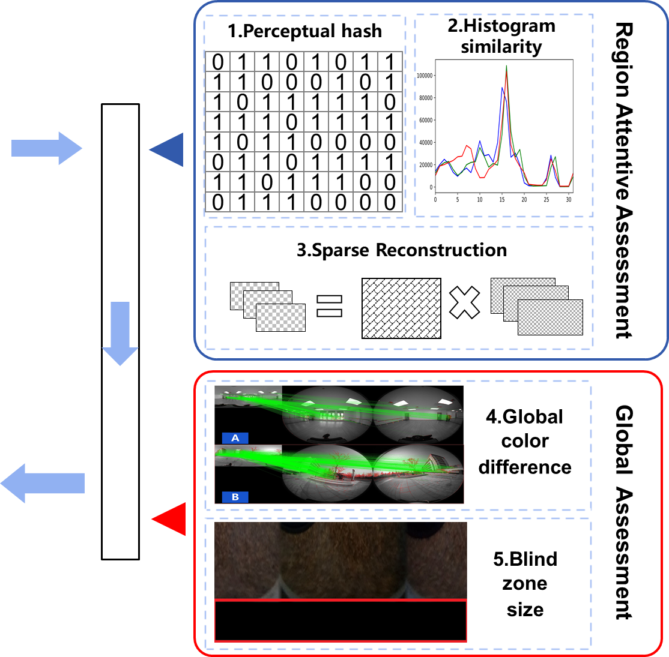
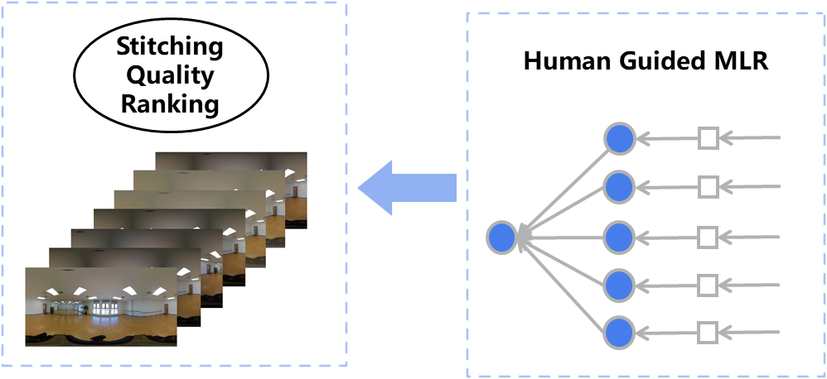
Overview
3 local metrics which focus on the quality of the stitching region
2 global metrics to evaluate the environmental immersion
Fuse by a guided linear classier to match the human subjective evaluations

Slide 10
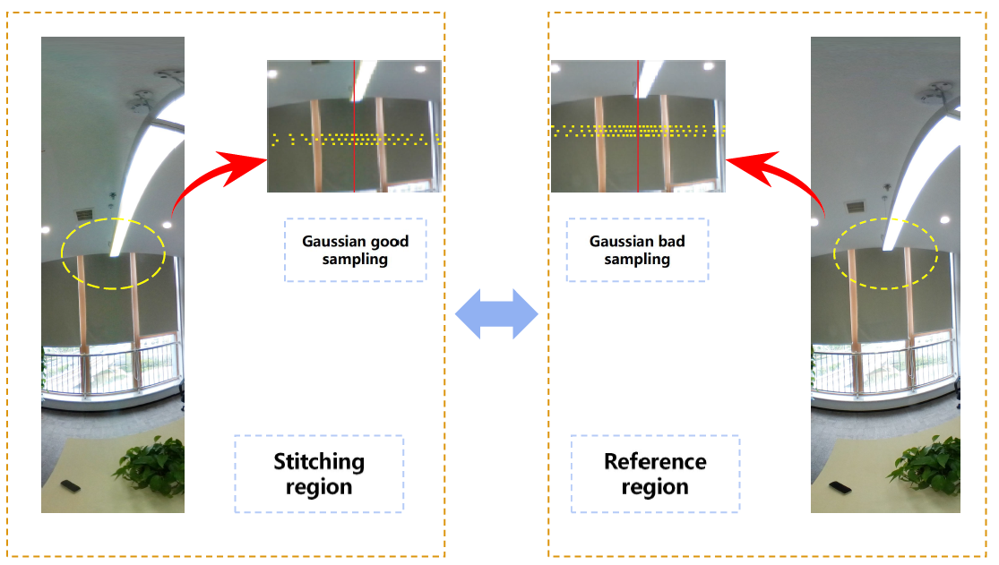
Method
Local indicators: Focus on Stitching Region
Sampling strategy: sampled 8×8 patches around the stitching region with normal distribution.
Near stitching seam: Dense sampling
Far from stitching seam: Sparse sampling

Slide 11
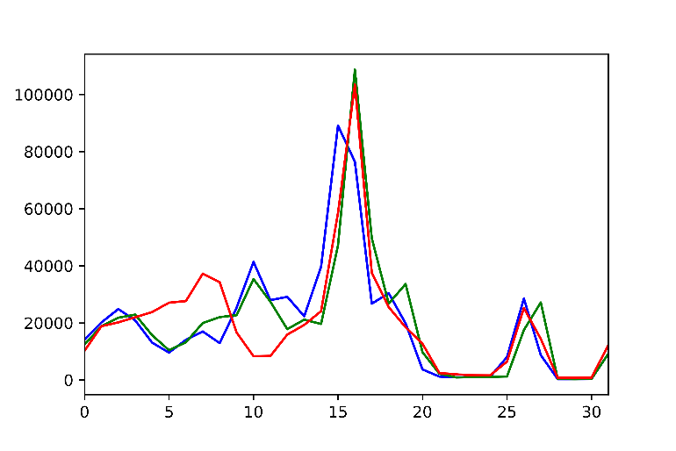
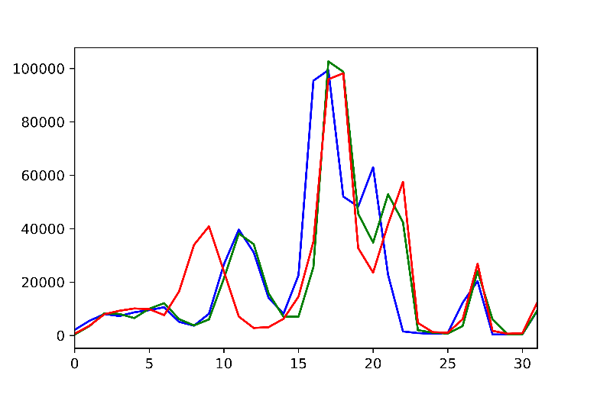
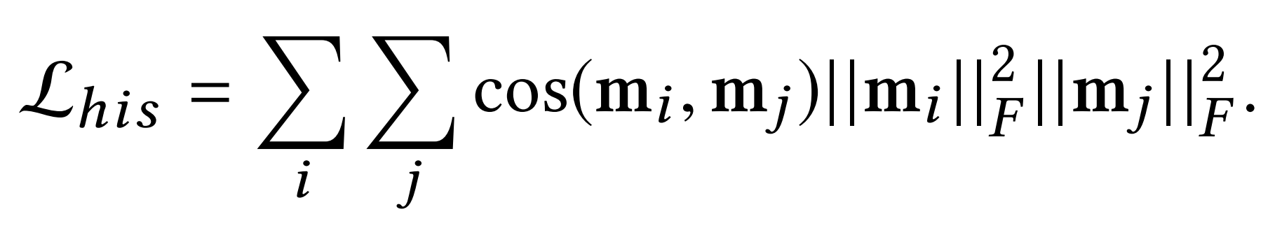
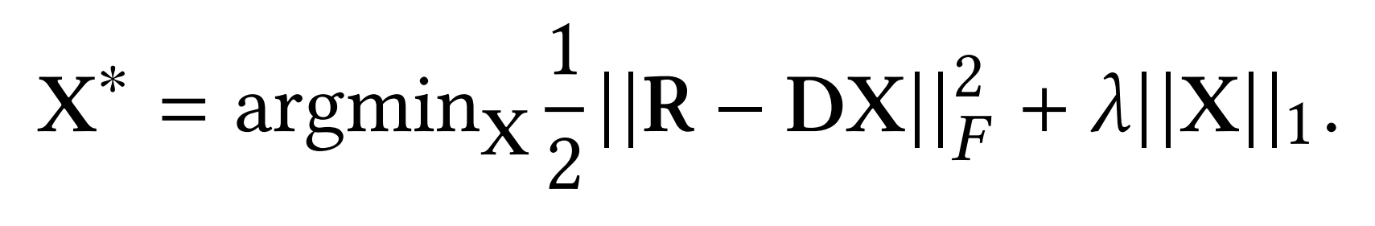
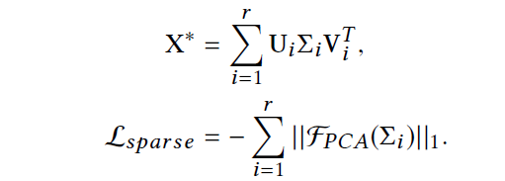
Method
Local indicators: Focus on Stitching Region
Histogram feature
Histogram feature difference
Perceptual hash
DCT transformation,
Hash distance of stitching region
Stitching
Reference
Sparse reconstruction
Sparse Reconstruction Similarity：
Sampled patches are adopted to construct dictionary D
The minimum vector that used by stitched image to reconstruct the reference ground truth.

Slide 12
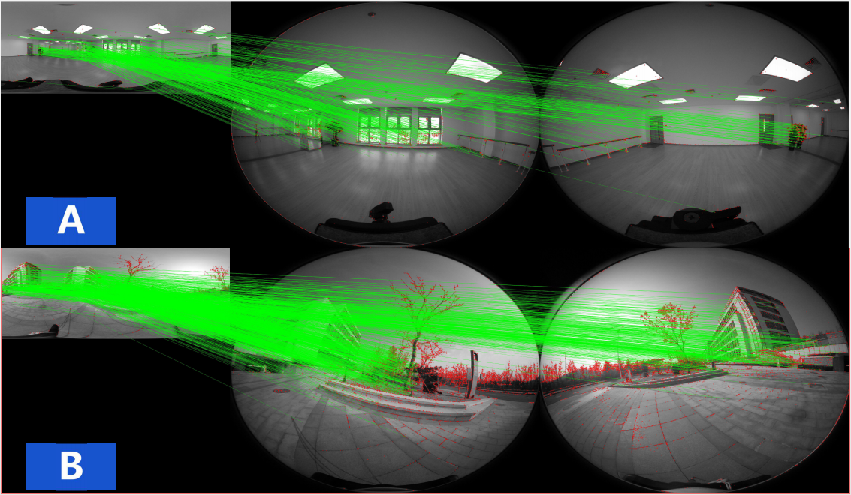
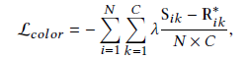
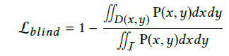
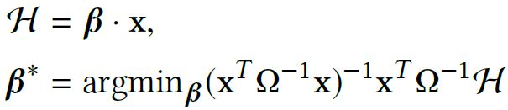
Method
Global indicators: Focus on whole Image
Color difference
Color difference:
Blind Zone:
Human Guided Classifier: learn weights to match the MOS evaluations

Slide 13
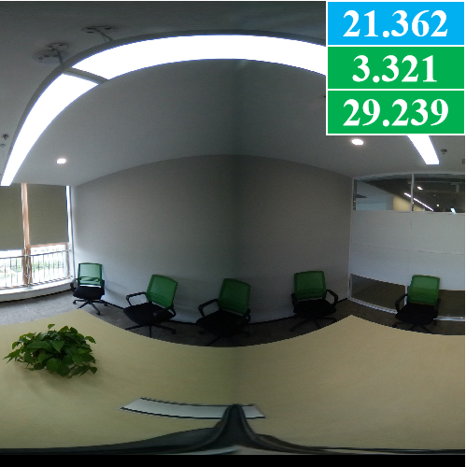
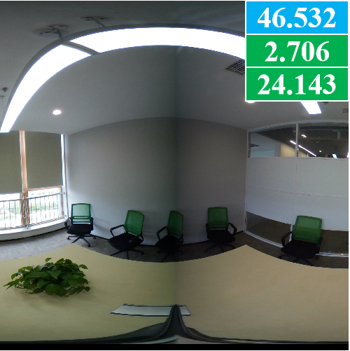
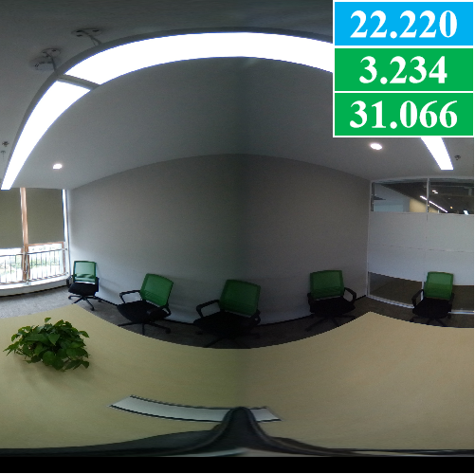
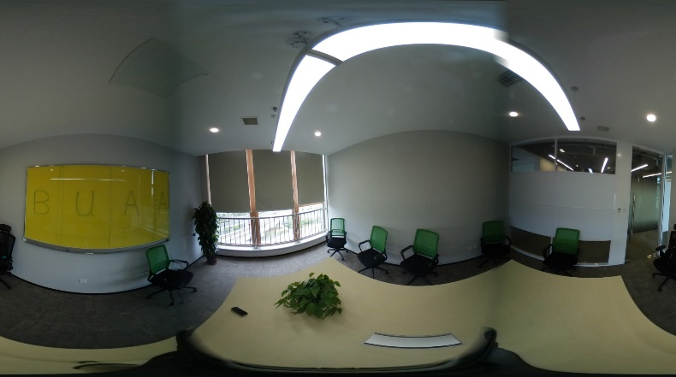
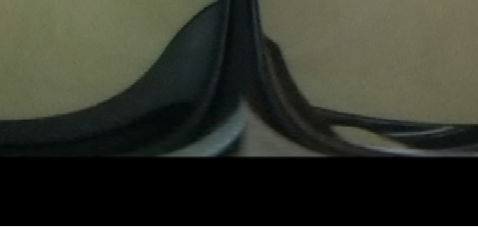



Method
Global indicators: Focus on whole Image
Color difference:
Blind Zone
Blind Zone:
EP
SVP
IP
MLS
Human Guided Classifier: learn weights to match the MOS evaluations

Slide 14

Experiments
Comparisons with 7 IQA methods with 5 evaluation criterions.
Ø IQA methods: MSE, PSNR, SSIM, BRISQUE, NIQE, PIQE, CNN-IQA
Ø Evaluation criterions: CS, PRCC, SROCC, KRCC, RMSE
Best Performance

Slide 15

Experiments
Qualitative benchmarking of 7 IQA methods.
OS-IQA scores: match the human subjective evaluations
The OS-IQA scores are shown in the top left corner (view in blue). The NIQE [21] and PIQE [23] are shown in the top right corner

Slide 16

Experiments
Local Indicators: blue color . NIQE, PIQE: orange color.
Our local indicators are more sensitive in stitching region than the other methods
31.17
43.48
27.17
27.57

Slide 17


Experiments
Ablation Study:
Impact of different components and different environments.
Perceptual hash takes the most contribution to the final score, which is also a widely used
indicator in fast but coarse image searching.
Method is robust for different conditions:
Indoor/outdoor
Natural-light/Artificial-light

Slide 18
Summarization
Establish the first cross-reference omnidirectional image
dataset which contains 292 quaternions of fisheye images and
the stitching results of seven methods
Propose a novel OS-IQA algorithm to automatically assess the stitching quality of 360◦ omnidirectional images
Outperforms the classic IQA metrics and is highly consistent with human subjective evaluations

Slide 19
THANK YOU!
Cross-Reference Stitching Quality Assessment for 360◦ Omnidirectional Images
Found us in P5B-02 !
Email: jiali@buaa.edu.cn
Website: http://cvteam.net
Notes:
And More details at poster session, thank you.

